Slide 1
ShakeTune 2.6.0-1 update

Slide 2
Klipper Update
scripts: Added shaper tuning parameters to calibrate_shaper script #6487
https://github.com/Klipper3d/klipper/pull/6487
https://github.com/Klipper3d/klipper/commit/72b301a2859c3f7ed26d802dd52fc495eef6c353

Slide 3
Why the update
Klipper added the ability to incorporate square_corner_velocity (SCV), and damping ratios to the built-in test_resonances command.
Frix_x took advantage of this and updated ShakeTune
What are the improvements:
ability to set a SCV velocity that we are actually using, or want to test, to determine smoothing.
Ability to set a max smoothing values and iterate through different SCV
Feeding the actual damping ratio (zeta) back into Klipper to get a more accurate shaper recommendations.

Slide 4
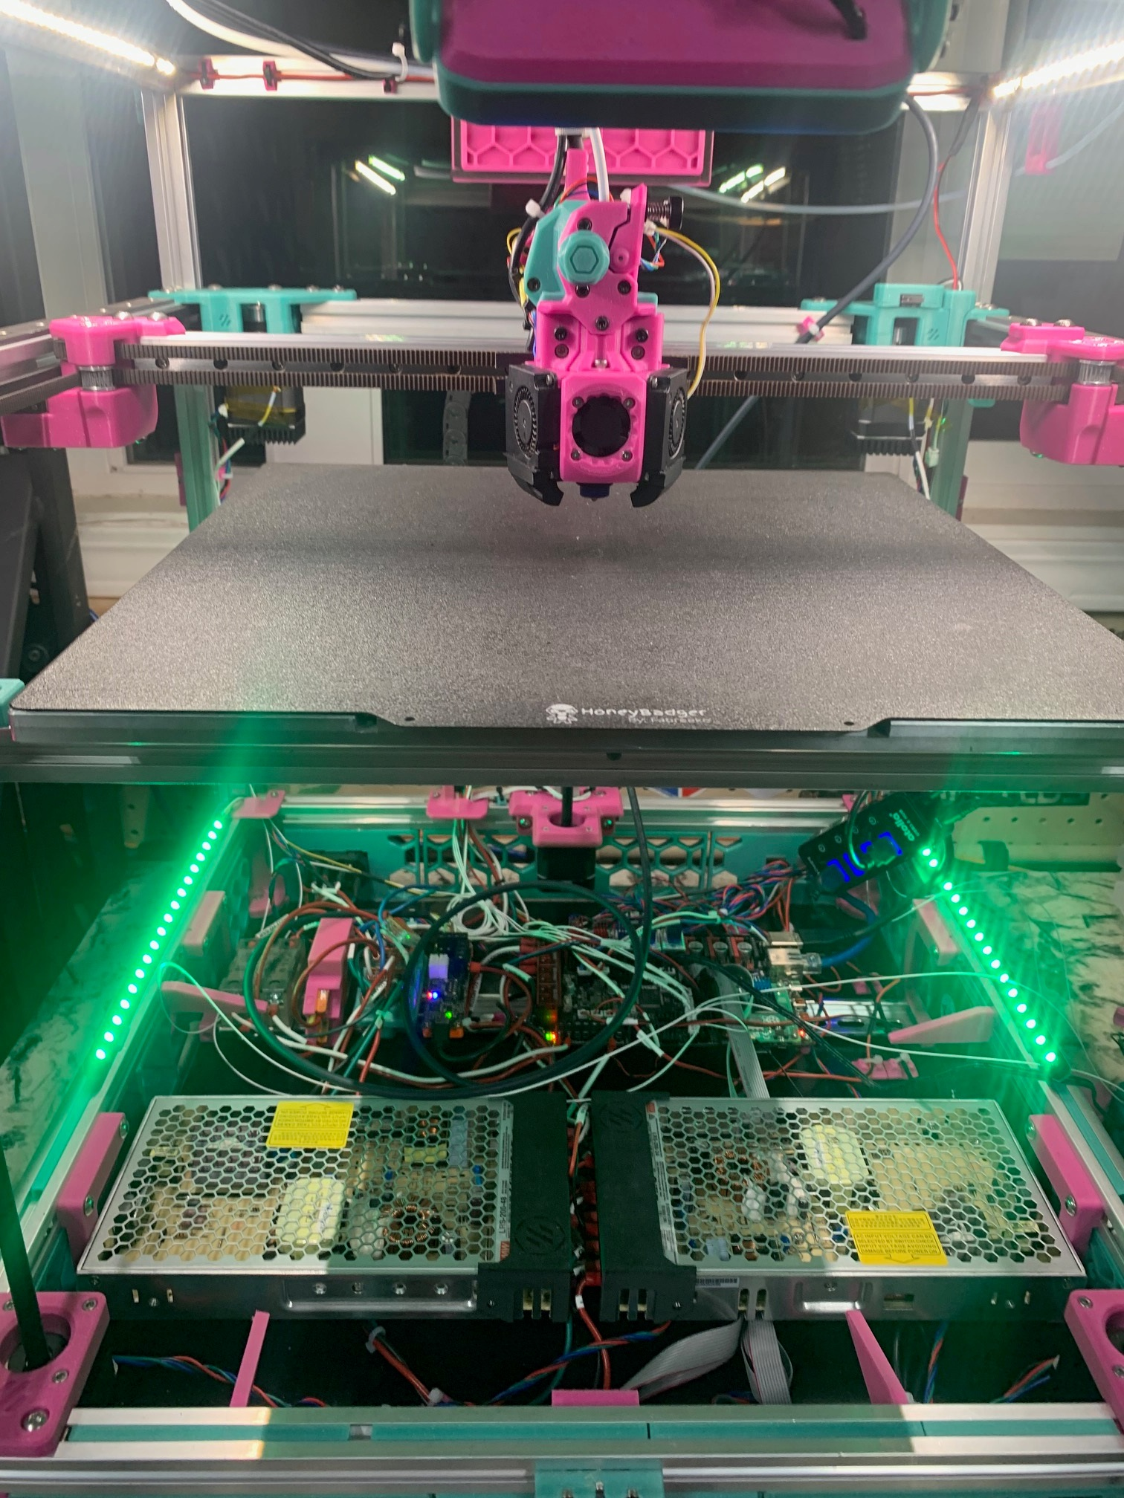
Pictures/ State of the printer
Voron Trident 350 – serial 1190
Mods:
Canbus
BTT Ebb36
Xol
Plastic Tap R8 (voron standard)
Inverted electronics
Bowden tube holder thingy
BFI front idlers
G2SA
48V XY
XY motors: ldo-42sth48-2804ac

Slide 5
ADXL.cfg
#########
Ebb36 canbus board
########
[adxl345]
cs_pin: toolhead:CS_ADXL
spi_software_sclk_pin: toolhead:ADXL
SCLK spi_software_mosi_pin: toolhead:ADXLMOSI spi_software_miso_pin: toolhead:ADXLMISO
#########
reasonance tester
#######
[resonance_tester]
accel_chip: adxl345
probe_points: 175, 175, 20 accel_per_hz: 100

Slide 6
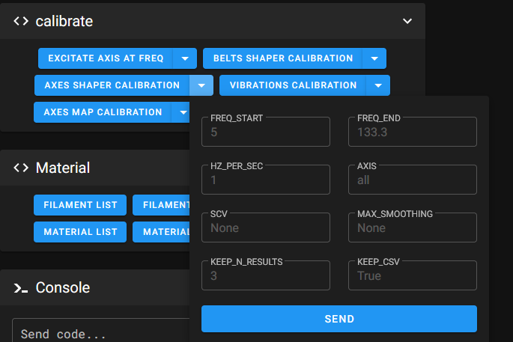

Slide 7
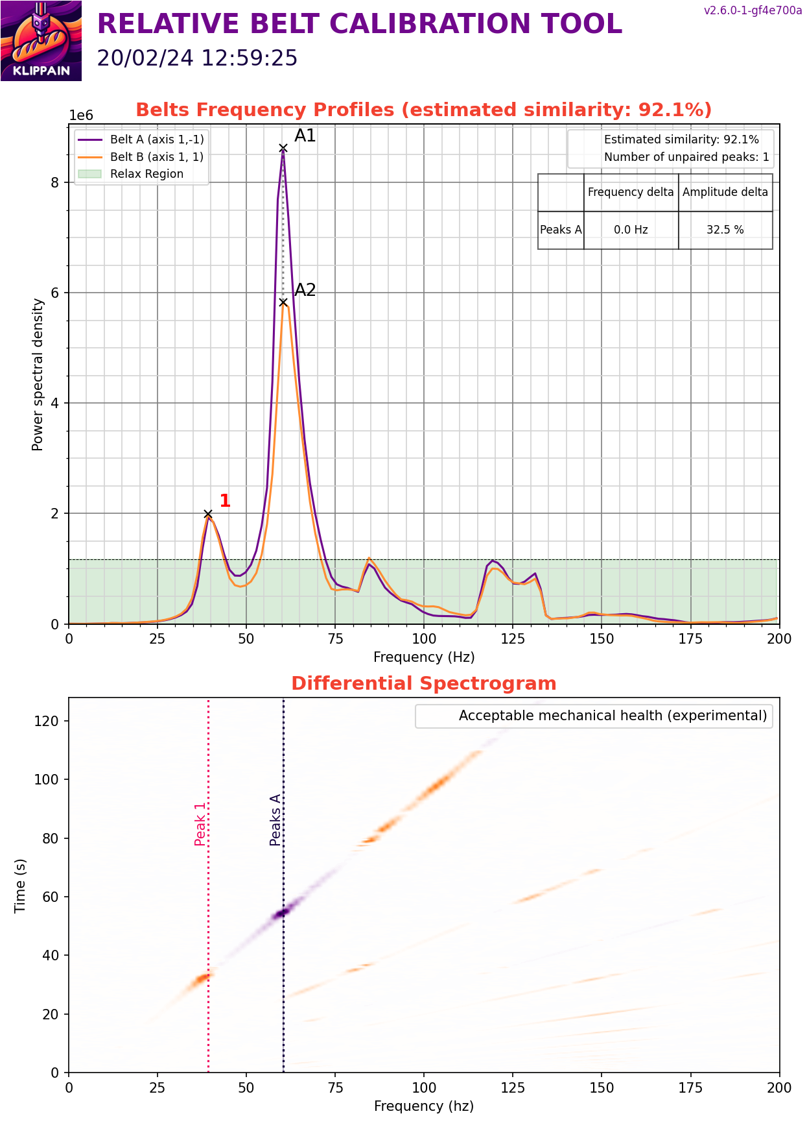

Slide 8
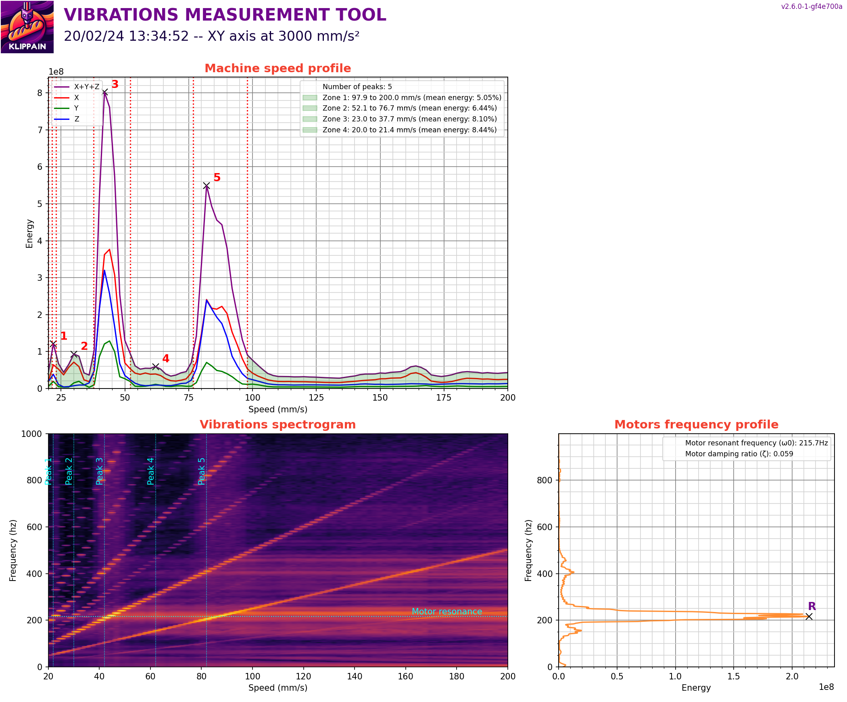

Slide 9
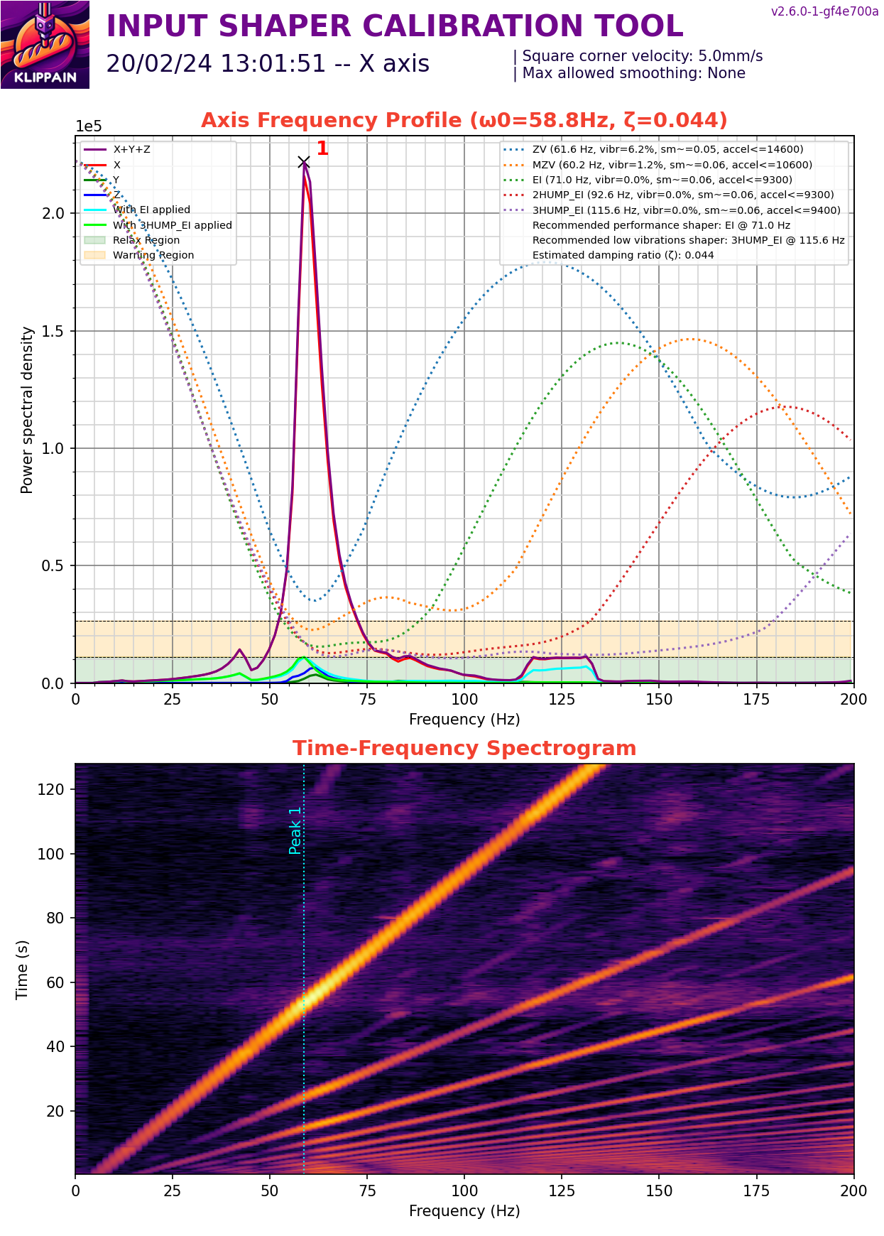
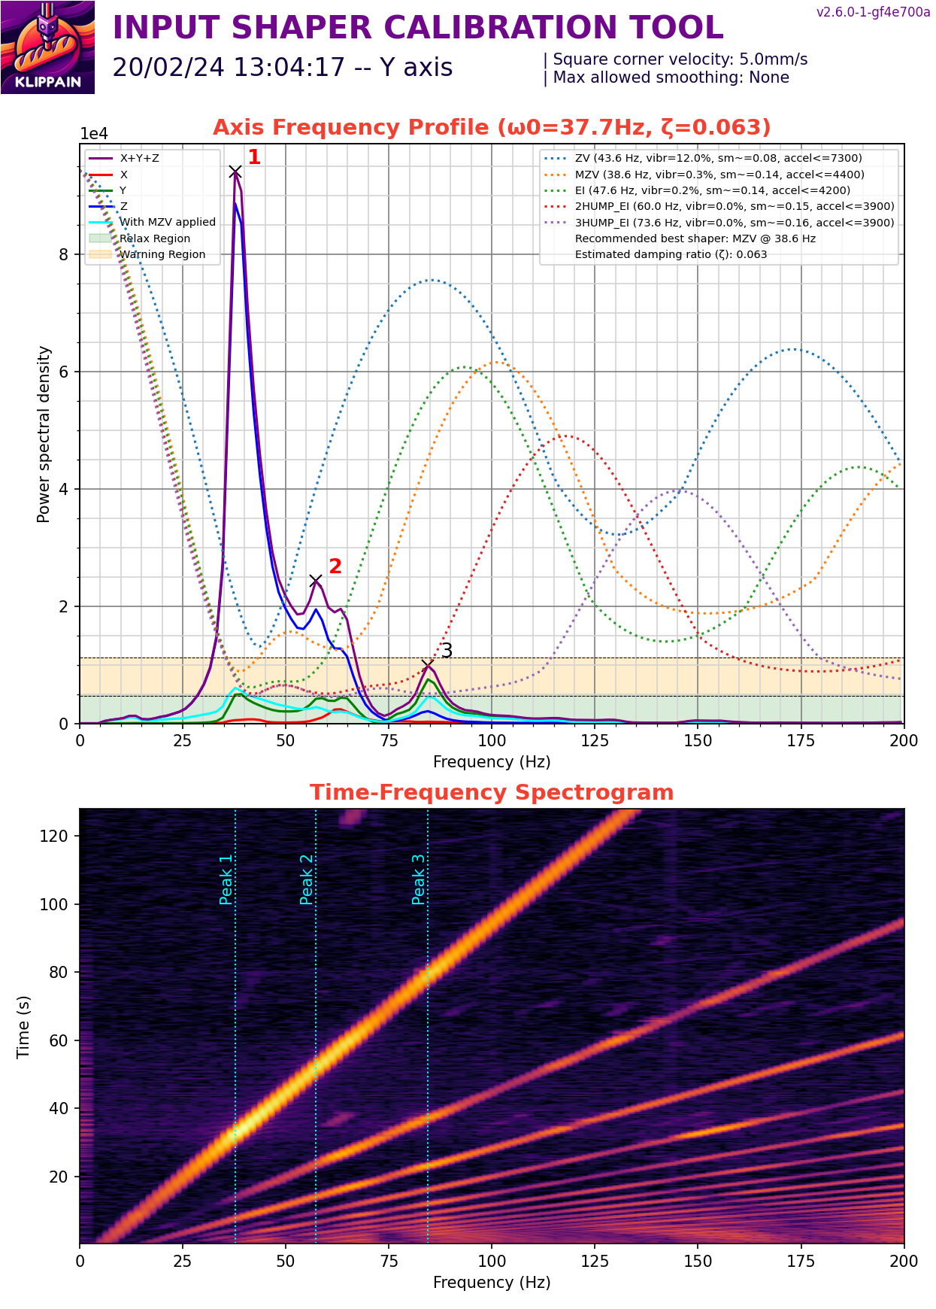

Slide 10
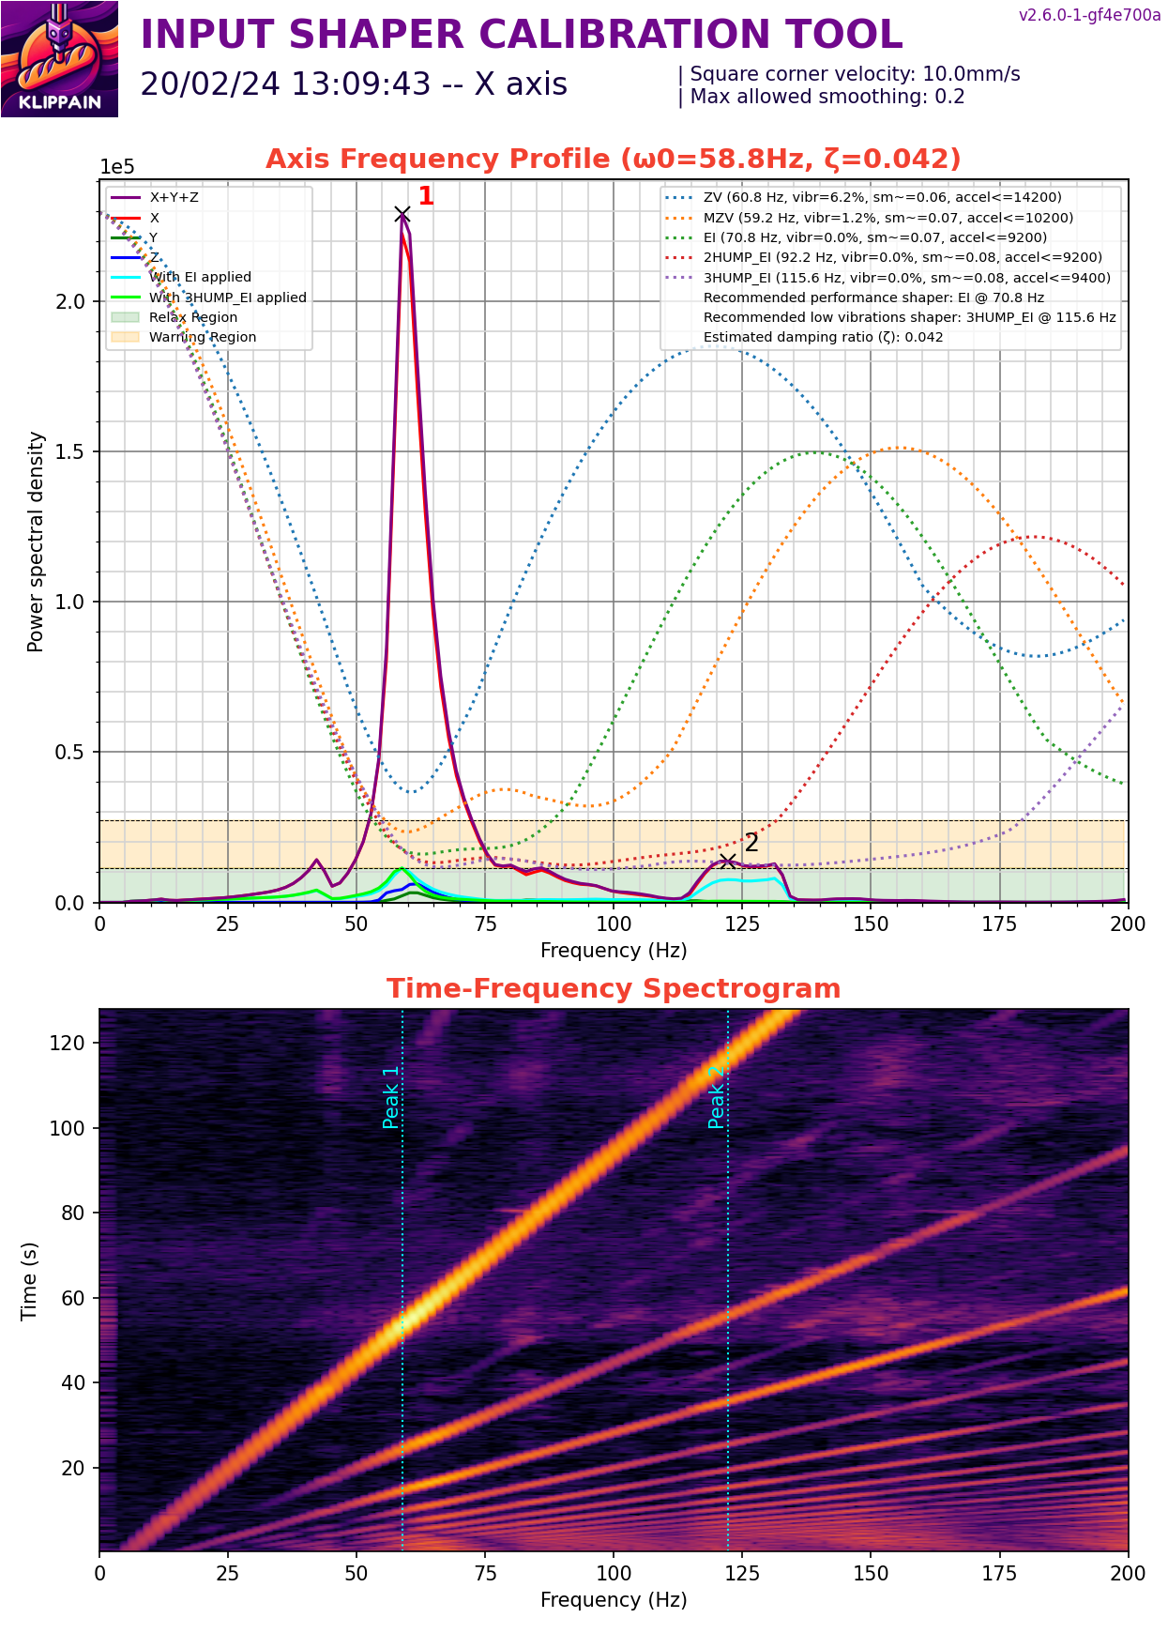


Slide 11
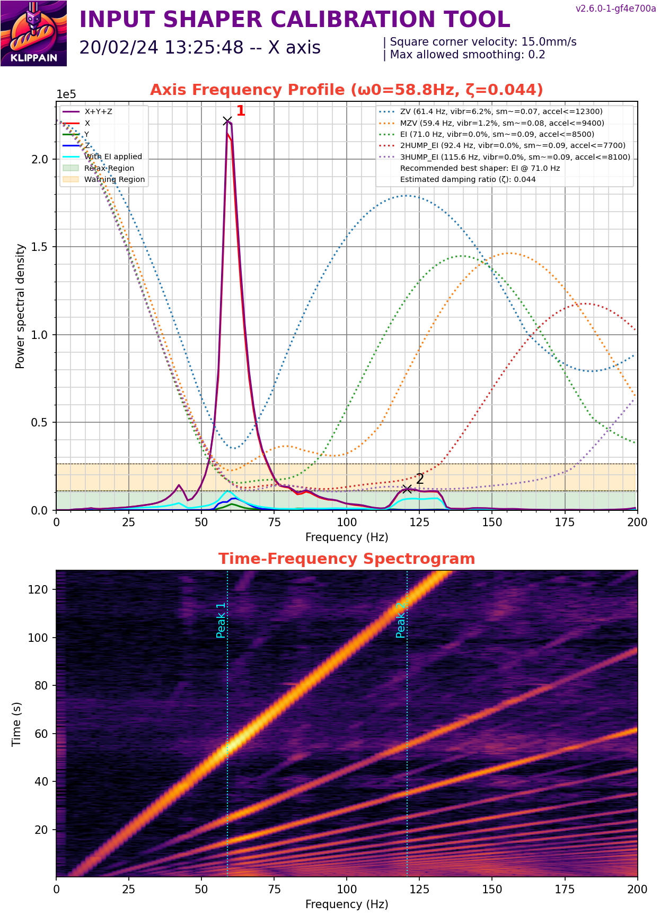


Slide 12
Standard SCV: 5-8
Max SCV: 10-12
Rough Calculated SCV – max accel on shaper/1000
4400/1000 = 4.4

Slide 13

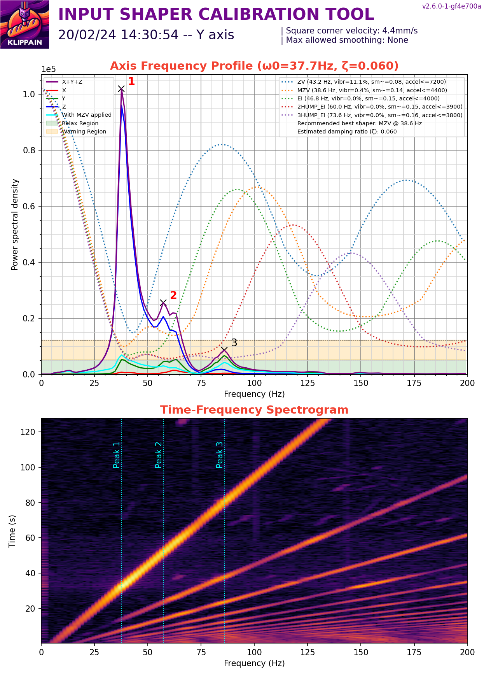

Slide 14
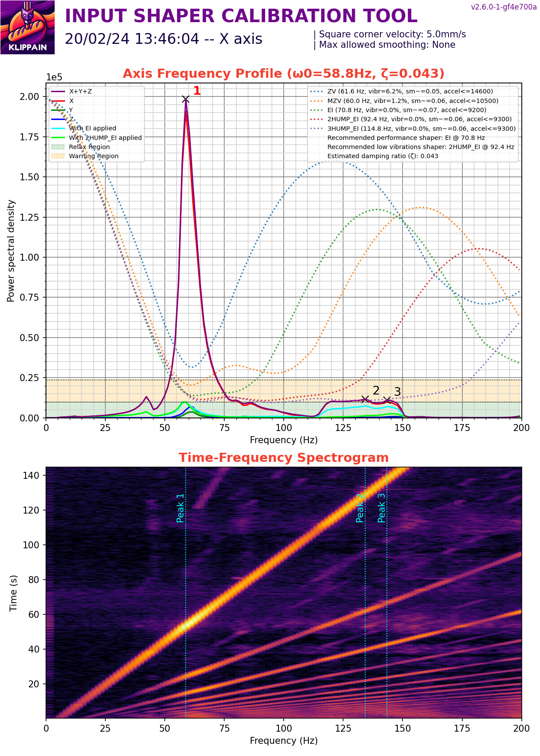
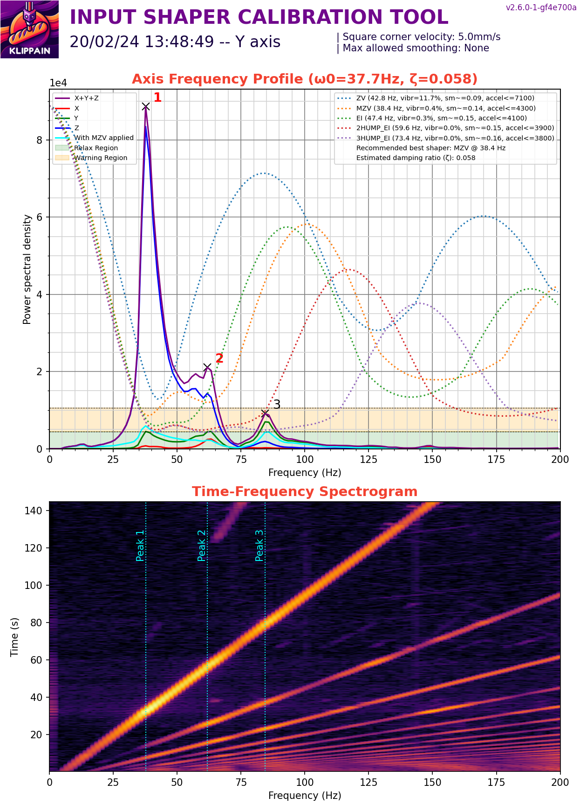
Changed freq_end to 150

Slide 15
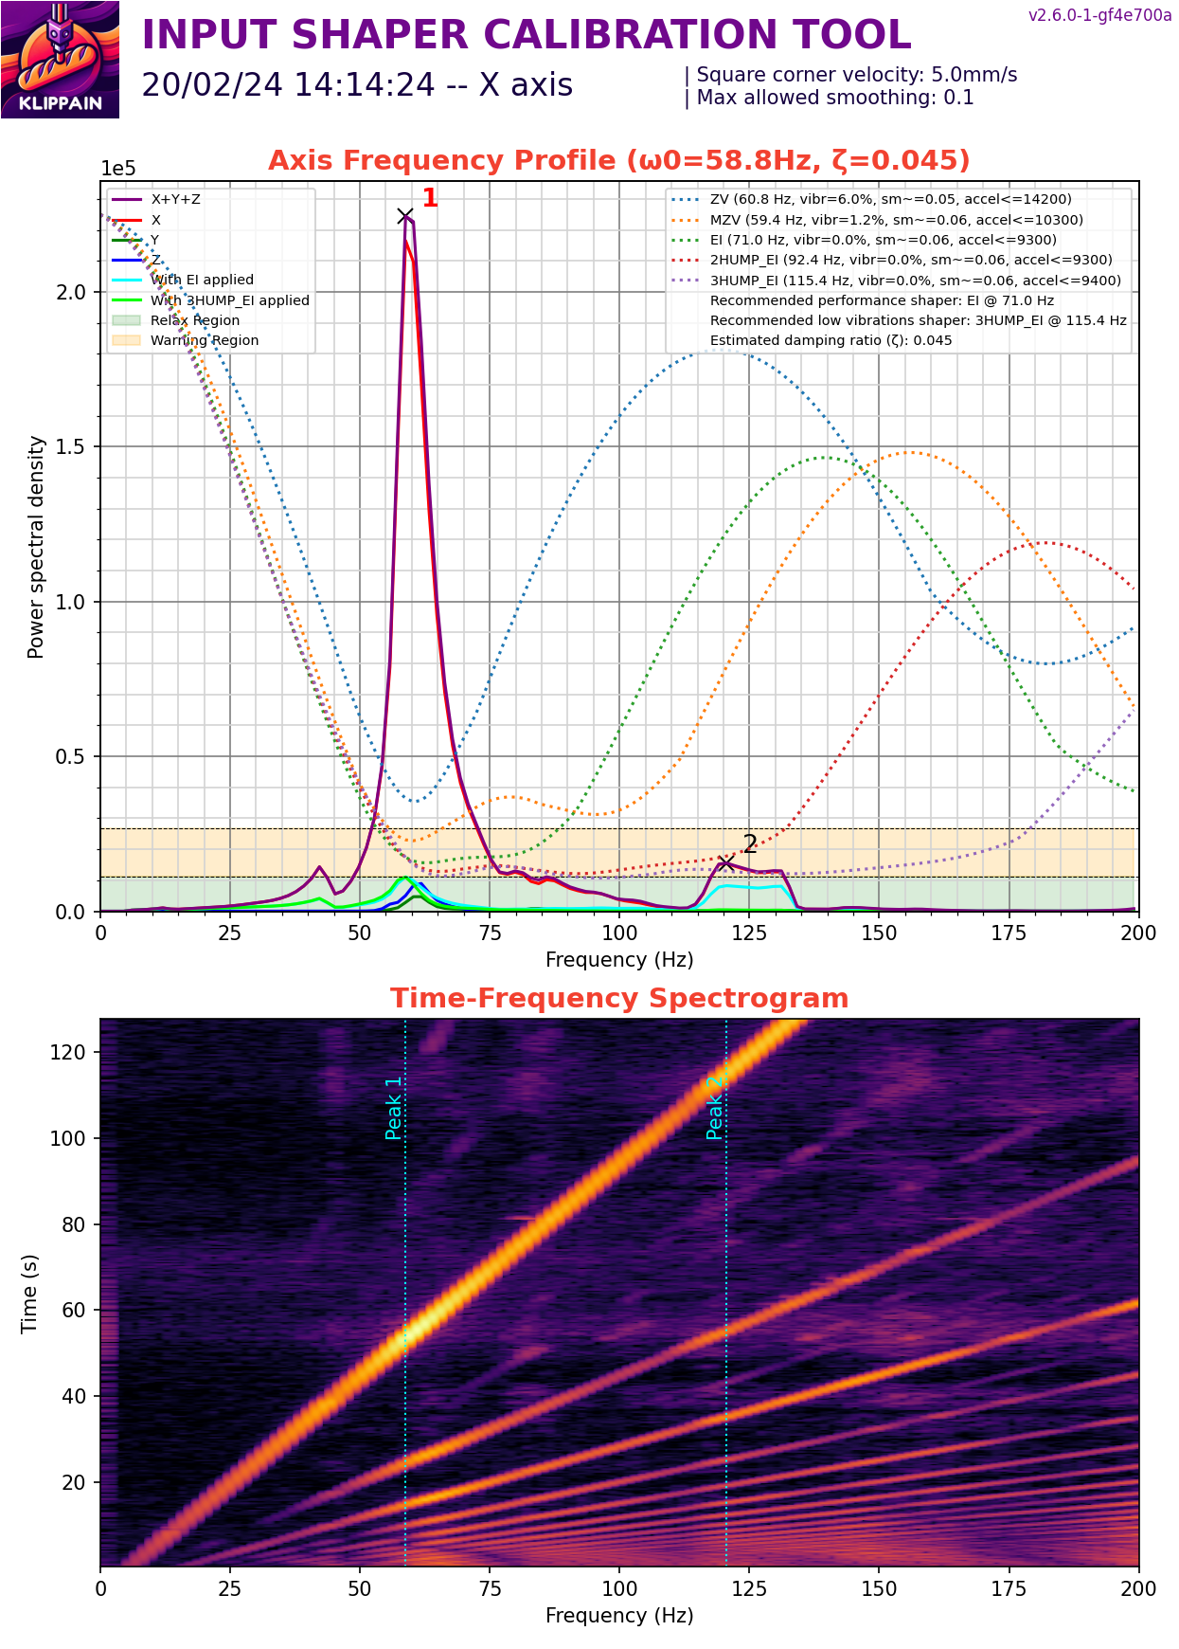
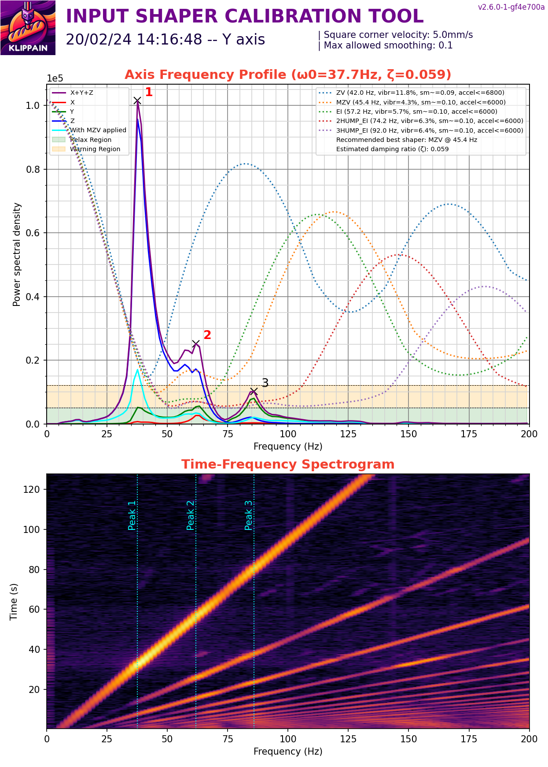
Limit sm to 0.1

